Slide 1
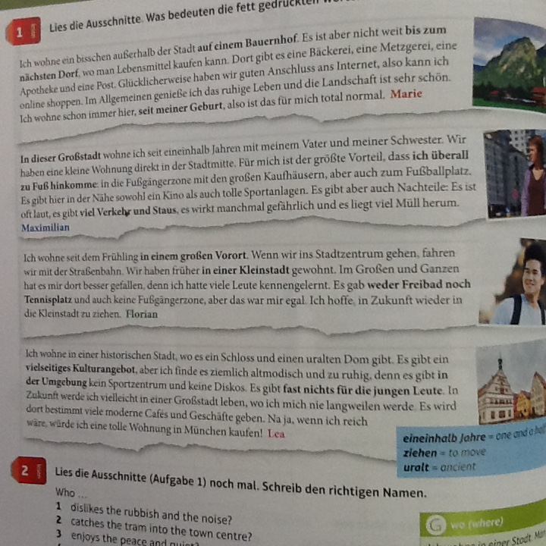
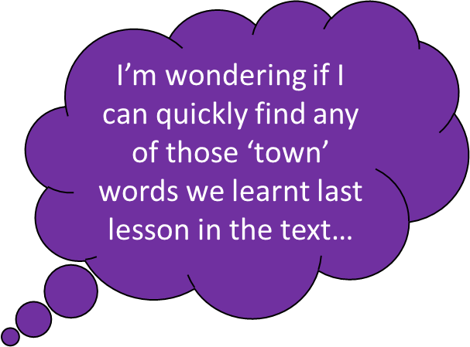
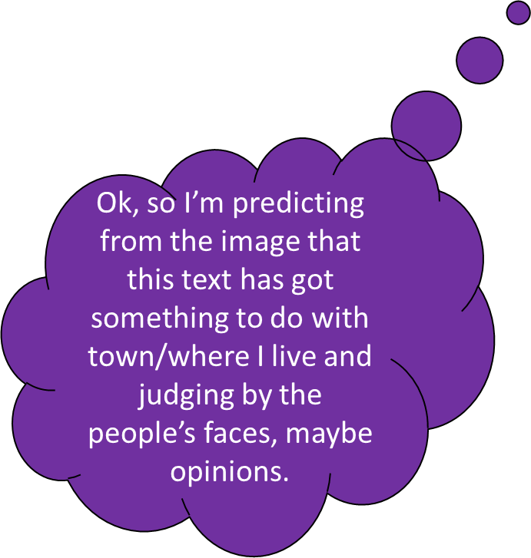
Bäckerei, Metzgerei, Apotheke, Post!’ I definitely recognise these. Phew! I’m pretty sure we learnt ‘Ich wohne’ for ‘I live’ too….

Slide 2
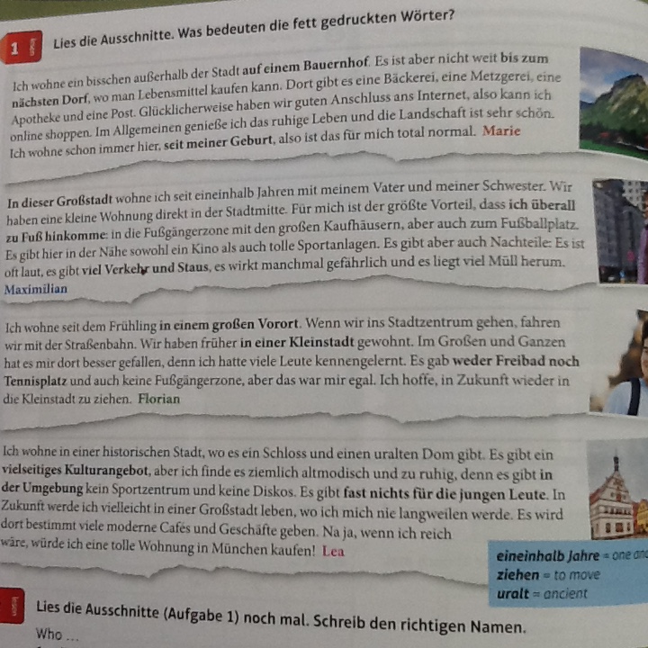
“I’m starting to think of the other places in town words that we had last lesson, where our crazy teacher showed us that clip on YouTube. “
Right, so based on all that ‘town’ vocab in there, I reckon it’s a text about where people live / what there is in their town.
“Hmm.. I wonder what’s on TV tonight. I mustn’t forget to buy a birthday card for Jules…”
I’m still not 100% sure so I might just check on Google Translate in the dictionary… Bingo!
I predict that I might find ‘es gibt’ or ‘wir haben’ in the text because all the places in town phrases started like that

Slide 3
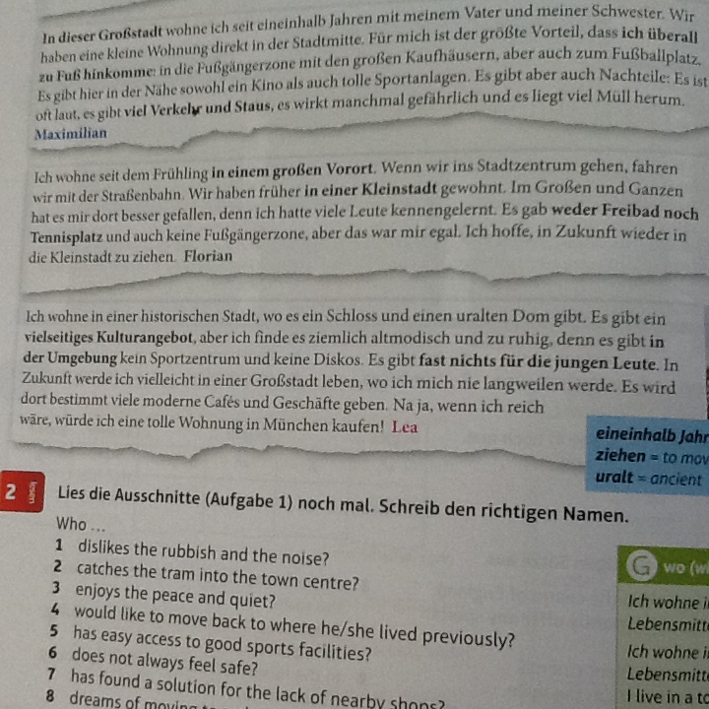
I’m confused by a couple of phrases. I’m trying to figure out what the ‘es wird… geben’ and ‘es gab’ bits are
I just thought of ‘es gibt’, which my teacher always says is the equivalent of ‘il y a’ in French. Could they be linked to that? Hold that thought…

Slide 4
“I’m confused about ‘Im Großen und Ganzen’ and ‘ziehen’ and what the heck is ‘Kulturangebot’?! (Why are German words always so long?!!)”
I’m seeing a lot of words I don’t recognise here…
…but I can also see some I do know: opinion words (besser/egal/altmodisch/ruhig)

Slide 5
‘ziehen’ doesn’t have a capital letter so it can’t be a noun and it ends in ‘en’ so it’s likely to be a verb of some sort, maybe the infinitive..
I recognise the 1st part ‘historische Stadt’ – it’s a cognate! And ‘keine’ is the ‘special K’ we learnt in Year 7 when we said we don’t have any pets so it must be something negative…”
Ah hang on… is that one of those compound thingy-s that Miss always goes on about? ‘Kultur’ is definitely a cognate so it must be ‘culture- something’… that might do for now.

Slide 6
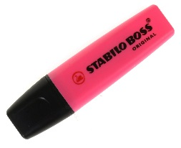
I can see ‘in Zukunft’, which I know means ‘in the future’ so that bit must be in the future tense. I wonder if there are any other tenses in this…hmm, I best re-read it and look for other tenses. I think I’ll use my highlighters to highlight the different tenses, it might be important.

Slide 7
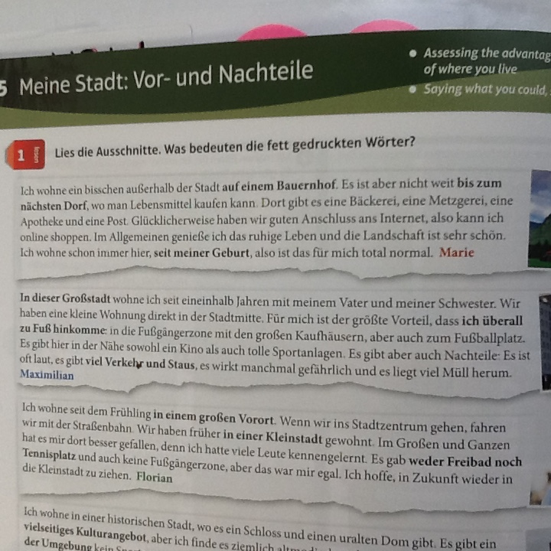
I just learned quite a few new words. I’m asking myself which ones I could use in my own work?
If I read the text through again I realise that there are a lot of things I can understand
Did I work out what es wird..geben” and “es gab..” meant? Do I need to ask someone to check?
What could I do next time we get a really long scary text to read?

Slide 9
I predict that…
I’m wondering…
I’m thinking…
I’m going to re-read this…
I can picture…
This reminds me of…
I’ll read on and check back…
I’m confused about…
I’m noticing…
I’m thinking…
A question I have is…
I believe…

